Slide 1
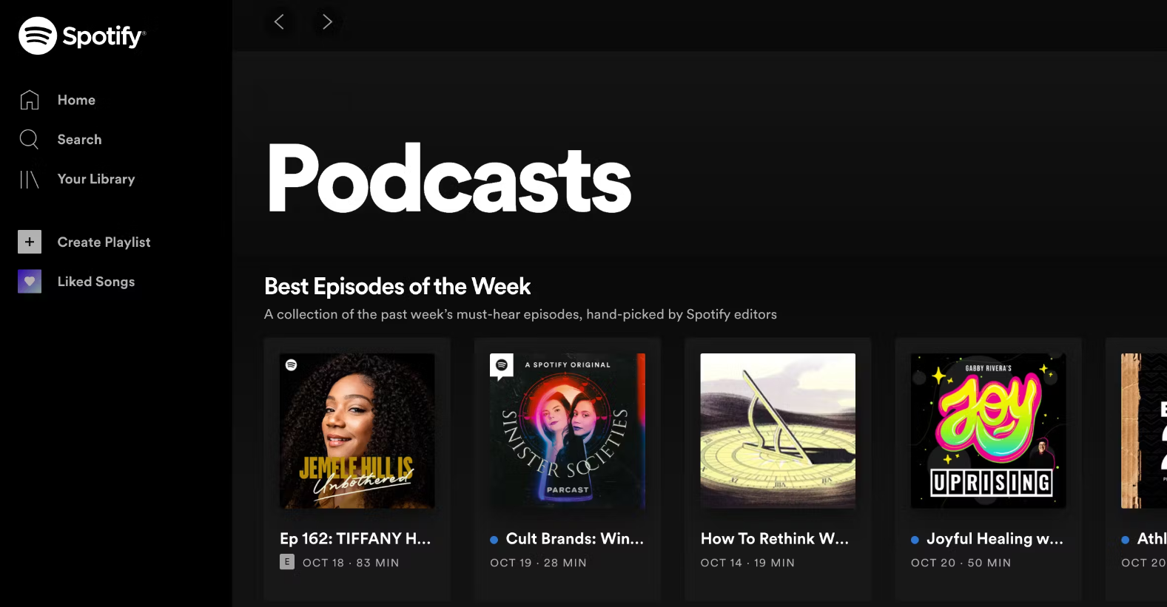
Inclusion of people with disability
Inclusion despite cultural differences
Appearance prejudices
LGBTQIA+ community inclusion
Exp
incl
Chiara and Viola
Vittoria, Marco and Viola
Emma, Magda and Elsa
Viola and viktoria
Teres
and M

Slide 2
Inclusion of people with disability
Chiara and Viola
35 6
3mm 56

Slide 3
Appearance prejudices
Vittoria, Marco and Viola
35 6
35 6
3mm 56
3mm 56

Slide 4
LGBTQIA+ community inclusion
Emma, Magda and Elsa
35 6
35 6
3mm 56
3mm 56

Slide 5
Inclusion despite cultural differences
Viola and Viktoria
35 6
35 6
3mm 56
3mm 56

Slide 6
Experienced inclusion
Teresa, Shamira and Michela
35 6
35 6
3mm 56
3mm 56

